Slide 1

POOJYA DODDAPPA APPA COLLEGE OF ENGINEERING
KALABURGI
Arduino-Based Fingerprint Voting System: Ensuring Accurate
and Fraud-Free Election
UNDER THE GUIDANCE OF
Dr. SHARANABASAPPA C GADAGE
(ASST. PROFESSOR, DEPT OF CSE)
PRESENTED BY:
ABHAY H D (3PD19CS001)
MADHURI R S (3PD19CS037)
MANSI B(3PD19CS043)

Slide 2
CONTENTS
Abstract
Introduction
Problem Statement
Literature review
Proposed System
Components description
Methodology
Implementation
Applications
Conclusion
References

Slide 3
ABSTRACT
In finger print based voting machine there is no need for the user to carry his ID which contains his required details. The person at the polling booth needs only to place his Finger on the device, thus allowing the acquisition of an on spot fingerprint from the voter which serves as an identification. The controller fetches the data from the reader and compares this data with the already existing data stored during the registration of the voters. If the data matches the pre-stored information of the registered fingerprint, the person can cast his vote.

Slide 4
INTRODUCTION
Voting is an essential right bestowed upon every citizen in a democratic country like India. This project utilizes fingerprint authentication to ensure the integrity of the voting process.
The fingerprints of eligible candidates are enrolled and stored in the system. During voting, the stored fingerprints are matched with the database, along with the corresponding Unique numbers, to verify the identity of the voter.
Fingerprint matching methods can be categorized into correlation-based matching, minutiae-based matching, and pattern-based (or image-based) matching.
The system also checks for any attempts at multiple voting, preventing malpractices. To enhance accessibility and efficiency, the voting system is designed to operate online using platforms like Google Spreadsheet.

Slide 5
PROBLEM STATEMENT
The traditional voting systems have been facing issues of fraud and errors in vote counting. Electronic voting systems have been introduced to overcome these challenges, but they are often expensive, complex, and require specialized knowledge to use. As a result, many people lack trust in the voting system, leading to legal challenges and disputes over election results. Therefore, the problem statement is to develop an affordable, easy-to-use, and reliable electronic-based fingerprint voting system using Arduino.

Slide 6
LITERATURE REVIEW
Name of author | Year of publication | Proposed methodology | Purpose
Mohammad Hosam Sedky, Essam Ramzy hamed | 2015 | Issues of security obstacles | Cost effective, accuracy and transparency problems in a highly secured approach.
Bhuvanapriya. R, Rozil Banu.S, Sivapriya.P | 2017 | Smart voting | Biometric and steganographic authentication, rsa algorithm .
Ramya Govindaraj, Kumaresan p, K.Sree Harshitha | 2020 | online voting system | It consumes time and can vote from anywhere through online.

Slide 7
Name of author | Year of publication | Proposed methodology | Purpose
Anandaraj S, Anish r, Devakumar p.V | 2015 | Exisiting voting system | Increasing the security, reliability, of the model and provide less time consumption to announce the result.
Rahil Rezwan, Huzaifa Ahmed, M. R. N. Biplob, S. M. Shuvo, md. Abdur Rahman | 2017 | electronic voting machine. | Stores fingerprint of the user
R. Murali prasad, Polaiah Bojja, Madhu Nakirekanti | 2016 | Aadhaar based voting machine | user login with the Aadhar number and a password.
Talib Divan | 2017 | A finger print matching technique | minute-based algorithm for voting system

Slide 8
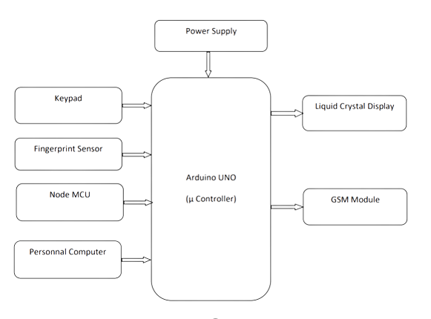
PROPOSED SYSTEM

Slide 9
In the proposed system, the voter begins by enrolling their ID number and fingerprint. This data is stored for verification purposes during the voting process. If there is a match, the system then checks if the voter has already cast a vote in the current election.
The keypad and fingerprint sensor serve as input devices, allowing users to provide necessary information and authenticate their identity.
Using the keypad, the voter enters an OTP (One-Time Password) provided to them. Once the OTP is validated, the voter can cast their vote by selecting their preferred candidate through the keypad.
This can be done by analyzing the recorded votes and generating a report or displaying the winner on an output device such as a display screen or personal computer.

Slide 10
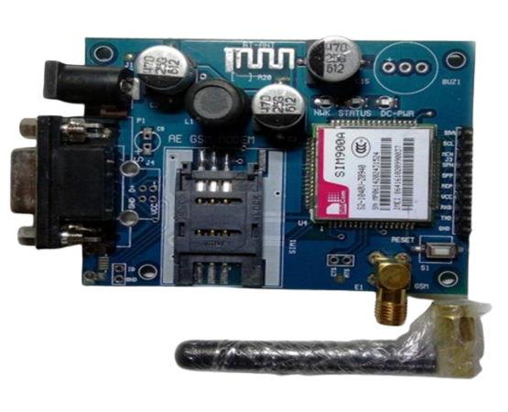
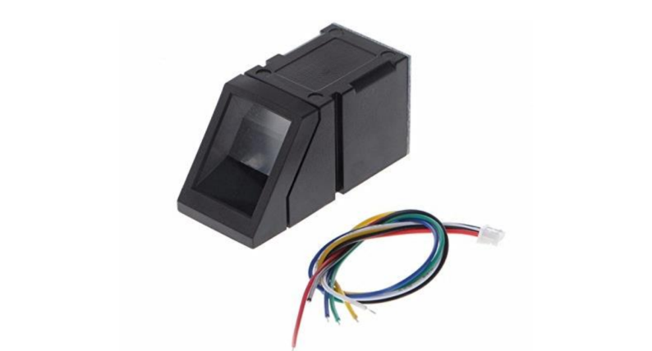
COMPONENT DESCRIPTION
GSM Module: In this project GSM module is used to send messages to every citizen to successful casting of vote, send alert messages to people who left to cast their vote and also send alert message to nearest police station.
FINGERPRINT MODULE: We are using R305 fingerprint module to enrol biometric data and verification of authorized voter to allow them to vote. There’s high power DSP Chip that does the image rendering, calculation, feature-finding, and searching.

Slide 11
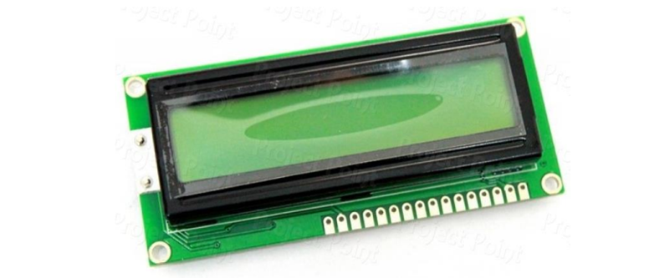
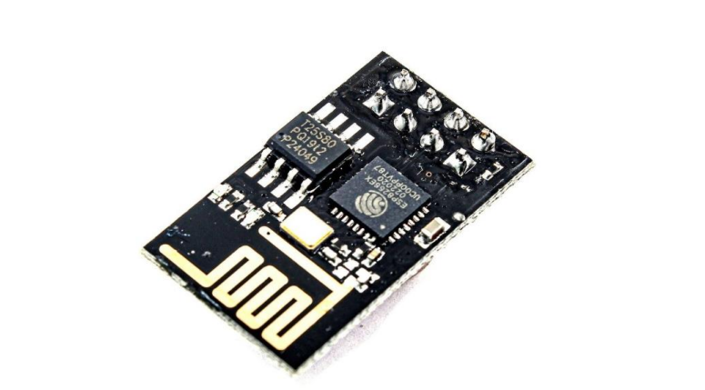
LCD DISPLAY: Here the voter will be allowed to proceed with choosing their preferred candidate from the panel of buttons, the final vote is displayed onto LCD for satisfaction of voters.
ESP8266-01WIFI MODULE: This module is used to sending polling votes to respective party automatically when citizens cast their votes and results to firebase Real time Database.

Slide 12
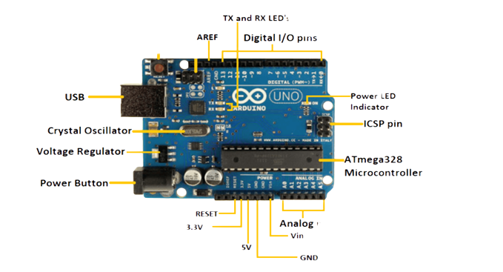
ARDUINO UNO: Arduino Uno (ATMEGA328) microcontroller is used for processing the data. It is heart of project and used to control all external peripherals. It controls the entire voting process like reading vote value, generating result and sending vote.

Slide 13
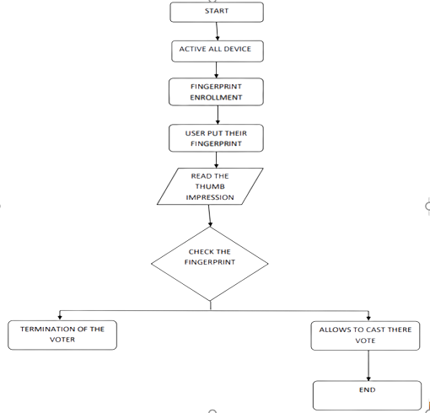

Slide 14
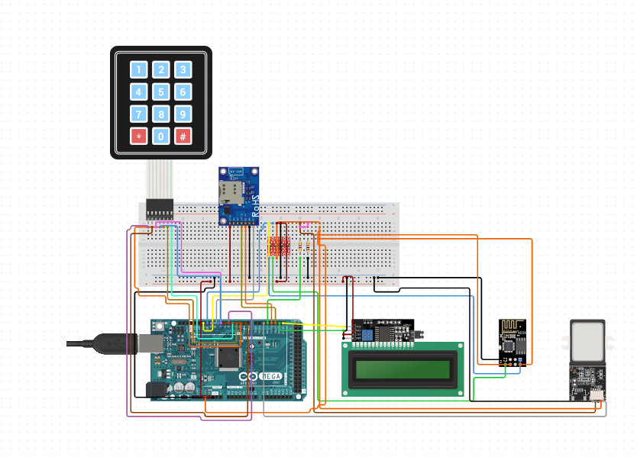
IMPLEMENTATION

Slide 15
The proposed system utilizes an Arduino UNO as the central component, acting as the main unit of the system.
It serves as the control hub and interface for various sub-units. These sub-units include a keypad, fingerprint sensor, personal computer, liquid crystal display (LCD), and a GSM module. The block diagram illustrates the interconnections and interactions between these components.
The Arduino UNO processes this input, communicates with the personal computer for data storage and analysis, and controls the display and communication functions through the LCD and GSM module, respectively.
The system's software aspect was developed using the Arduino sketch programming language on a personal computer.

Slide 16
METHDOLOGY
The functional block diagram of the IoT based voting machine with fingerprint verification consist of controller, fingerprint module, Wi-Fi module, keypad, power supply and a cloud.
The controller used in this system is arduino Uno. Keypad is used to poll the vote. Message regarding the system instructions and any malpractice will be displayed on the serial monitor.
Fingerprint module identifies the fingerprint of each user with the fingerprint in the database and displays a message if it belongs to an authenticated person. It will give the result of matching on the serial monitor.
The fingerprint sensor scans the voter's finger for identification, and the display unit displays the measurement instrument's results.

Slide 17
APPLICATIONS
This project can be used as a voting machine to prevent rigging, during the elections in the polling booths.
Fast track voting which could be used in small scale elections, like resident welfare association, “panchayat” level election and other society level elections, where results can be instantaneous
It could also be used to conduct opinion polls during annual shareholders meeting.
It could also be used to conduct general assembly elections where number of candidates are less than or equal to eight in the current situation, on a small-scale basis.

Slide 18
CONCLUSION
In conclusion, the implemented Arduino-Based Biometric Voting System has successfully addressed the challenges of accuracy and fraud in elections. By combining biometric verification, secure cloud storage, and real-time monitoring, the system provides a robust and transparent framework for conducting credible and fraud-free elections. This system can be a valuable tool in promoting democracy and ensuring the integrity of electoral processes participate in the election, maintaining the integrity of the voting process.

Slide 19
REFERENCES
https://ijcrt.org/papers/IJCRT2205157.pdf
https://www.researchgate.net/publication/332909681_Design_and_Development_of_an_Arduino_Based_Electronic_Voting_System
https://ijariie.com/AdminUploadPdf/Secured_Fingerprint_Based_Voting_System_using_IoT_ijariie16386.pdf
https://www.ijnrd.org/papers/IJNRD1805004.pdf
http://www.ijarse.com/images/fullpdf/1522501810_BIT814jarse.pdf

Slide 20
THANK YOU

